Slide 1
Public transport analysis

Slide 2
AFLAH C REEGAN AAKISH C SAM DANIEL EBINESH SANJAY

Slide 3
Processing Data: extract unstructured transportation records and process them to build your optimization model Improving Visibility: using Python visualization libraries to get clarity on current routing and truck loading rate Simulating Scenarios: build a model to simulate multiple routing scenarios and estimate the impact on average cost per ton

Slide 4
. Problem Statement Retail Stores Distribution with Full Truck Load (FTL) 1 Warehouse delivering stores by using three types of Trucks (3.5T, 5T, 8T) 49 Stores delivered 12 Months of Historical Data with 10,000 Deliveries 7 days a week of Operations 23 Cities 84 Trucks in your fleet

Slide 5
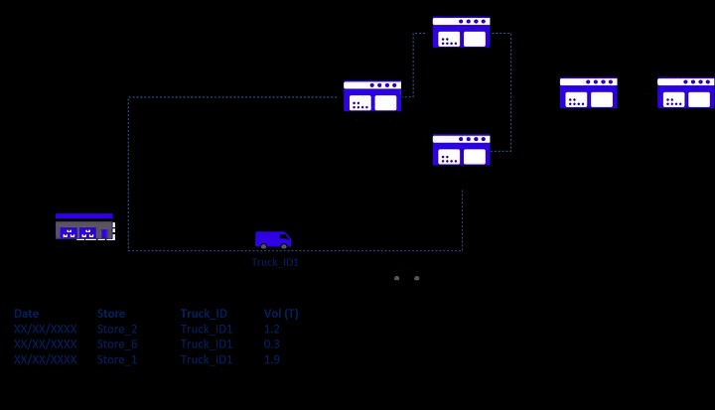

Slide 6
Raw dataset
City_En, 3.5T (Rmb) , 5T (Rmb) , 8T (Rmb) ,3.5T (Rmb/Ton),5T (Rmb/Ton),8T (Rmb/Ton) City_1, 485 , 650 , 800 , 139 , 130 , 100 City_2, 640 , 700 , 820 , 183 , 140 , 103 City_3, 690 , 780 , 890 , 197 , 156 , 111 City_4, 810 ,” 1,000 “,” 1,150 “, 231 , 200 , 144 City_5,” 1,300 “,” 1,568 “,” 1,723 “, 371 , 314 , 215 City_6,” 1,498 “,” 1,900 “,” 2,100 “, 428 , 380 , 263 City_7, 980 ,” 1,250 “,” 1,450 “, 280 , 250 , 181 City_8,” 1,350 “,” 1,450 “,” 1,500 “, 386 , 290 , 188 City_9,” 1,350 “,” 1,450 “,” 1,500 “, 386 , 290 , 188 City_10, 850 ,” 1,000 “,” 1,200 “, 243 , 200 , 150

Slide 7
Data processing
Understand the Current Situation 1. Import Datasets Before starting to think about the optimization model, your priority is to understand the current situation. Starting with unstructured data coming from several sources, we’ll need to build a set of data frames to model our network and provide visibility on the loading rate and list of stores delivered for each route.

Slide 8
Date,Truck_ID,Store_ID,FTL,Order,BOX,SKU,Loading (Tons) 9/1/2016,Truck_ID1,Store_ID1,3.5,16,311,83,2.404 9/1/2016,Truck_ID1,Store_ID2,3.5,18,178,83,1.668 9/1/2016,Truck_ID2,Store_ID3,3.5,10,74,54,0.81 9/1/2016,Truck_ID2,Store_ID4,3.5,19,216,88,2.413 9/1/2016,Truck_ID3,Store_ID5,3.5,10,117,54,1.119 9/1/2016,Truck_ID3,Store_ID6,3.5,15,294,92,2.962 9/1/2016,Truck_ID4,Store_ID7,3.5,5,42,19,0.421 9/1/2016,Truck_ID4,Store_ID8,3.5,12,125,88,1.138 9/1/2016,Truck_ID5,Store_ID9,5,18,201,95,2.19

Slide 9
Store address
Code,city,Long,Lat,address Store_ID1,City_Store1,31.952792,118.8192708,Address_1 Store_ID2,City_Store2,31.952792,118.8192718,Address_2 Store_ID3,City_Store3,31.675948,120.7468221,Address_3 Store_ID4,City_Store4,31.664448,120.7700006,Address_4 Store_ID5,City_Store5,31.750971,119.9478857,Address_5 Store_ID6,City_Store6,31.791351,119.9232302,Address_6 Store_ID7,City_Store7,31.79233,119.9768294,Address_7 Store_ID8,City_Store8,31.982972,119.5832084,Address_8 Store_ID9,City_Store9,31.996161,119.6341775,Address_9 Store_ID10,City_Store10,31.885547,121.1886473,Address_10 Store_ID11,City_Store11,30.310079,120.1515734,Address_11 Store_ID12,City_Store12,31.383616,121.2569408,Address_12 Store_ID13,City_Store13,31.387863,121.2797154,Address_13

Slide 10
Transport cost
City_En, 3.5T (Rmb) , 5T (Rmb) , 8T (Rmb) ,3.5T (Rmb/Ton),5T (Rmb/Ton),8T (Rmb/Ton) City_1, 485 , 650 , 800 , 139 , 130 , 100 City_2, 640 , 700 , 820 , 183 , 140 , 103 City_3, 690 , 780 , 890 , 197 , 156 , 111 City_4, 810 ,” 1,000 “,” 1,150 “, 231 , 200 , 144 City_5,” 1,300 “,” 1,568 “,” 1,723 “, 371 , 314 , 215 City_6,” 1,498 “,” 1,900 “,” 2,100 “, 428 , 380 , 263 City_7, 980 ,” 1,250 “,” 1,450 “, 280 , 250 , 181 City_8,” 1,350 “,” 1,450 “,” 1,500 “, 386 , 290 , 188 City_9,” 1,350 “,” 1,450 “,” 1,500 “, 386 , 290 , 188 City_10, 850 ,” 1,000 “,” 1,200 “, 243 , 200 , 150

Slide 11
Listing of stores delivered by each route
# Create Transport Plan def transport_plan(data, dict_trucks, capacity_dict): # List of Stores per Truck for each DAY df_plan = pd.DataFrame(data.groupby([‘Date’, ‘TruckID’])[‘Code’].apply(list)) df_plan.columns = [‘List_Code’] # List of Box Quantity df_plan[‘List_BOX’] = data.groupby([‘Date’, ‘TruckID’])[‘BOX’].apply(list) # Mean of FTL df_plan[‘FTL’] = data.groupby([‘Date’, ‘TruckID’])[‘FTL’].mean() df_plan[‘Capacity(T)’] = df_plan[‘FTL’].map(capacity_dict) df_plan[‘List_Loading’] = data.groupby([‘Date’, ‘TruckID’])[‘Loading(T)’].apply(list) df_plan[‘Count’] = df_plan[‘List_Loading’].apply(lambda t: len(t)) df_plan[‘Total_tons(T)’] = data.groupby([‘Date’, ‘TruckID’])[‘Loading(T)’].sum() # Distribute: one shipment per col # Stores d = df_plan[‘List_Code’].apply(pd.Series) for col in d: df_plan[“Store%d” % (col+1)] = d[col] # Boxes number d = df_plan[‘List_BOX’].apply(pd.Series) for col in d: df_plan[“Box%d” % (col+1)] = d[col]

Slide 12
D = df_plan[‘List_Loading’].apply(pd.Series) for col in d: df_plan[“Tons%d” % (col+1)] = d[col] # Fill NaN + Drop useless columns df_plan.fillna(0, inplace = True) if 1 == 0: df_plan.drop([‘List_Code’], axis = 1, inplace = True) df_plan.drop([‘List_BOX’], axis = 1, inplace = True) df_plan.drop([‘List_Loading’], axis = 1, inplace = True) return df_plan

Slide 13
Date,TruckID,List_Code,Capacity(T),List_Loading,Count,Total_tons(T),Store1,Store2,Store3,Store4,Box1,Box2,Box3,Box4,Tons1,Tons2,Tons3,Tons4,Occupation(%),Available(T) 9/1/2016,Truck_ID1,[‘Store_ID6’],3.5,[2.91],1,2.91,ID6,0,0,0,243,0,0,0,2.91,0,0,0,83.14,0.59 9/1/2016,Truck_ID2,”[‘Store_ID34’, ‘Store_ID22’, ‘Store_ID9’]”,3.5,”[0.3, 1.37, 0.47]”,3,2.14,ID34,ID22,ID9,0,31,116,44,0,0.3,1.37,0.47,0,61.14,1.36 9/1/2016,Truck_ID3,[‘Store_ID18’],3.5,[1.5],1,1.5,ID18,0,0,0,174,0,0,0,1.5,0,0,0,42.86,2 9/1/2016,Truck_ID4,[‘Store_ID37’],3.5,[2.3],1,2.3,ID37,0,0,0,179,0,0,0,2.3,0,0,0,65.71,1.2 9/1/2016,Truck_ID5,”[‘Store_ID34’, ‘Store_ID48’]”,3.5,”[2.14, 0.51]”,2,2.65,ID34,ID48,0,0,168,46,0,0,2.14,0.51,0,0,75.71,0.85

Slide 14
Add cities covered by each route
Pricing Functions def f_maxcity(list_cities, list_price): return list_cities[list_price.index(max(list_price))] # Index of Maximum Price def inner_stops(list_cities, max_city): return list_cities.count(max_city) – 1 def outer_stops(list_cities, max_city): return len(list_cities) – (list_cities.count(max_city)) def total_price(max_price, inner_stops, outer_stops, inner_price, outer_price): return max_price + inner_stops * inner_price + outer_stops * outer_price # Calculate Price def plan_price(df_strinfo, df_plan, inner_price, outer_price): # Dictionnary Ville dict_ville = dict(zip(df_strinfo.Code.values, df_strinfo.City.values)) # Price per Truck Size： 3.5T, 5T, 8T dict_35, dict_5, dict_8 = [dict(zip(df_strinfo.City.values, df_strinfo[col].values)) for col in [‘3.5T’, ‘5T’, ‘8T’]]

Slide 15
# Mapping Cities f_ville = lambda t: [dict_ville[i] for i in t] # literal_eval(t) # Mapping Price f_35 = lambda t: [dict_35[i] for i in t] f_5 = lambda t: [dict_5[i] for i in t] f_8 = lambda t: [dict_8[i] for i in t] # Mapping Price df_plan[‘List_City’] = df_plan[‘List_Code’].map(f_ville) df_plan[‘List_Price35’] = df_plan[‘List_City’].map(f_35) df_plan[‘List_Price5’] = df_plan[‘List_City’].map(f_5) df_plan[‘List_Price8’] = df_plan[‘List_City’].map(f_8) # Maximum Price City f_maxprice = lambda t: max(t) # Maximum Price

Slide 16
Mapping First City df_plan[‘Max_Price35’] = df_plan[‘List_Price35’].map(f_maxprice) df_plan[‘Max_Price5’] = df_plan[‘List_Price5’].map(f_maxprice) df_plan[‘Max_Price8’] = df_plan[‘List_Price8’].map(f_maxprice) df_plan[‘Max_City’] = df_plan.apply(lambda x: f_maxcity(x.List_City, x.List_Price35), axis = 1) # Inner City Stop df_plan[‘Inner_Stops’] = df_plan.apply(lambda x: inner_stops(x.List_City, x.Max_City), axis = 1) df_plan[‘Outer_Stops’] = df_plan.apply(lambda x: outer_stops(x.List_City, x.Max_City), axis = 1) # Total Price df_plan[‘Price35’] = df_plan.apply(lambda x: total_price(x.Max_Price35, x.Inner_Stops, x.Outer_Stops, inner_price, outer_price), axis = 1) df_plan[‘Price5’] = df_plan.apply(lambda x: total_price(x.Max_Price5, x.Inner_Stops, x.Outer_Stops, inner_price, outer_price), axis = 1) df_plan[‘Price8’] = df_plan.apply(lambda x: total_price(x.Max_Price8, x.Inner_Stops, x.Outer_Stops, inner_price, outer_price), axis = 1) return df_plan

Slide 17
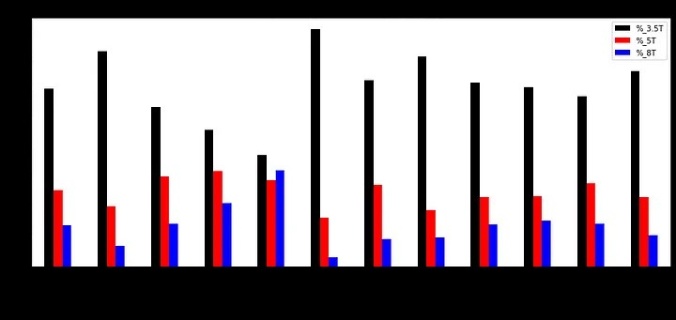

Slide 18
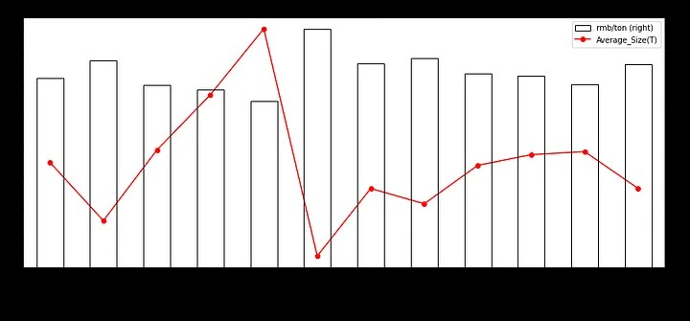

Slide 19

Transportation Plan Visualisation

Slide 20
UNDER THE GUIDANCE OF ARUNA C

